Slide 1
Computability
Turing machines and the limits of computation

Slide 2

undecidable problems

Slide 3
Computation
Is it possible to compute anything/everything that can be computed? What does this even mean?
How easy is it to learn the notation of a programming language?
How “easy” is it to describe a computation (e.g., write a program)?
What metrics do we use to determine whether it is “easy” to write a program (e.g., symbol count)?

Slide 4
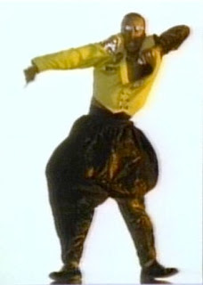
Two views
Church’s Conjecture
Any computation for which there exists an effective procedure can be realized by a Turing machine.
Sapir-Whorf Hypothesis
It may be possible for an individual working in one language to imagine thoughts that cannot be expressed in another language, and cannot be understood by those using this other language.

Slide 5
Problem solving

Slide 6
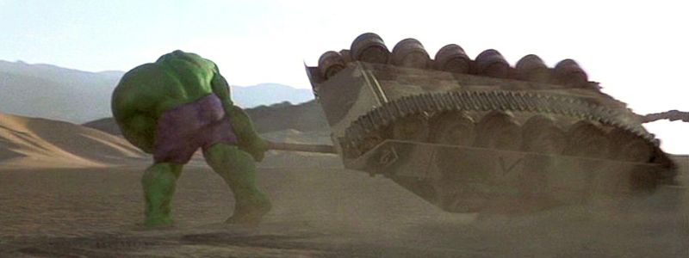
Work harder
“Hulk smash!” said the Hulk.

Slide 7

Think smarter
You think that’s air you’re breathing now?

Slide 8
Computable functions
Gödel's incompleteness results divided the set of all possible
functions into two sets:
Computable functions: Those functions that are decidable. That is, for which effective computations can be discovered.
Non-computable functions: The set of undecidable functions. Those functions for which no effective computations exist.

Slide 9

undecidable
decidable

Slide 10
Connection to programming languages
A very important question when designing a computational framework is:
A language for which the answer to the above question is “yes” is called a universal model of computation.
It is not possible to develop a programming language that is more powerful (in the sense that it can compute more functions) than a universal model of computation.
In this framework, will it be possible to compute all computable functions?

Slide 11
The turing machine
A universal model of computation

Slide 12
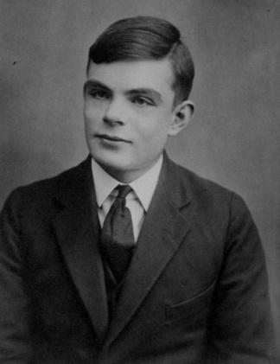
Alan turing
Alan Turing (1912-1954) is widely considered to be the father of theoretical computer science and artificial intelligence.
The Turing Award is the highest award in the field of computer science.
Turing personally broke the form of Enigma that was used by the U-boats preying on the North Atlantic merchant convoys.

Slide 13
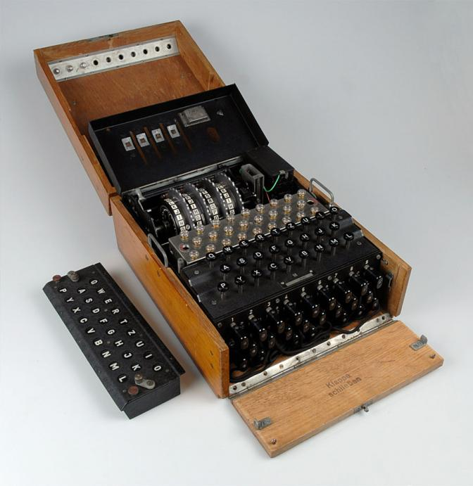
The enigma machine
The UK government did not disclose details of the efforts to crack the Enigma machine until 1974.

Slide 14
Some historians estimate that Bletchley Park's massive codebreaking operation, especially the breaking of U-boat Enigma, shortened the war in Europe by as many as two to four years.
At a conservative estimate, each year of the fighting in Europe brought on average about seven million deaths, so the significance of Turing's contribution can be roughly quantified in terms of the number of additional lives that might have been lost if he had not achieved what he did.
If U-boat Enigma had not been broken, and the war had continued for another two to three years, a further 14 to 21 million people might have been killed.
Source: Alan Turing: The codebreaker who saved 'millions of lives‘
by Jack Copeland

Slide 15
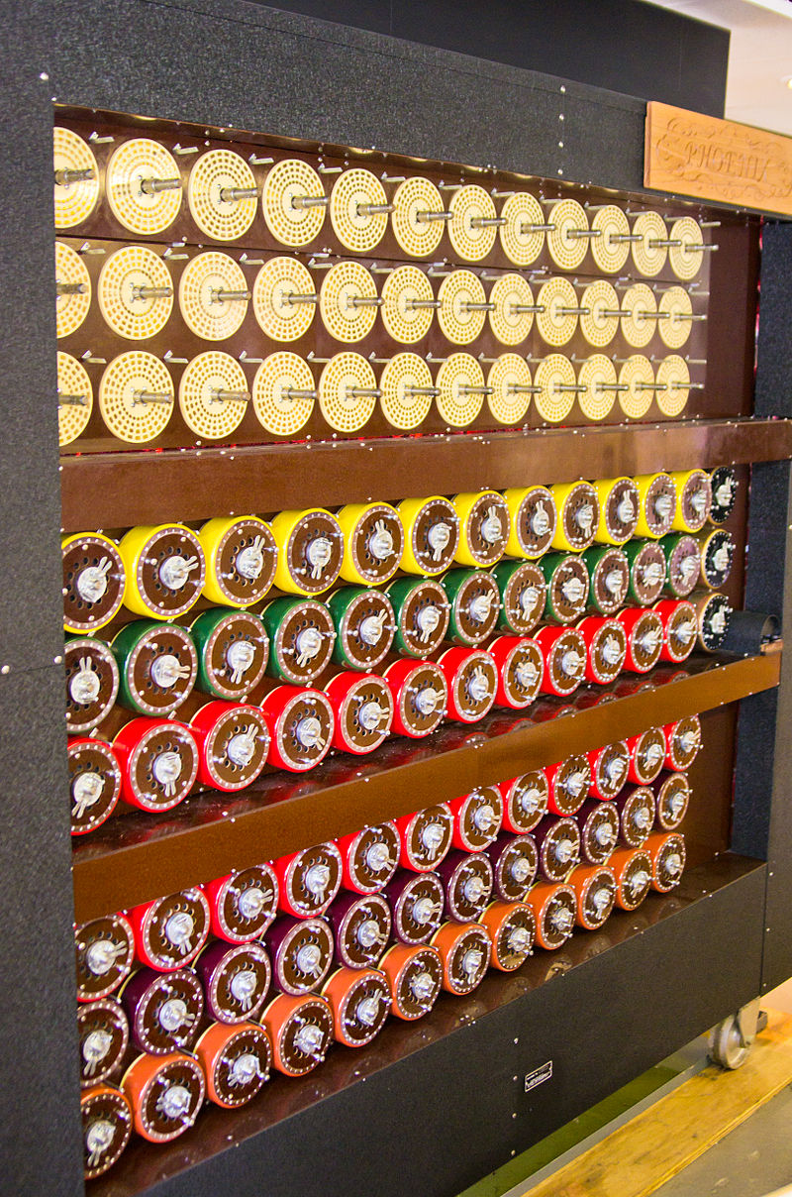
the bombe (seriously this machine was “da bombe”)
Designed by Alan Turing at Bletchley Park
Purpose: to break Enigma codes

Slide 16
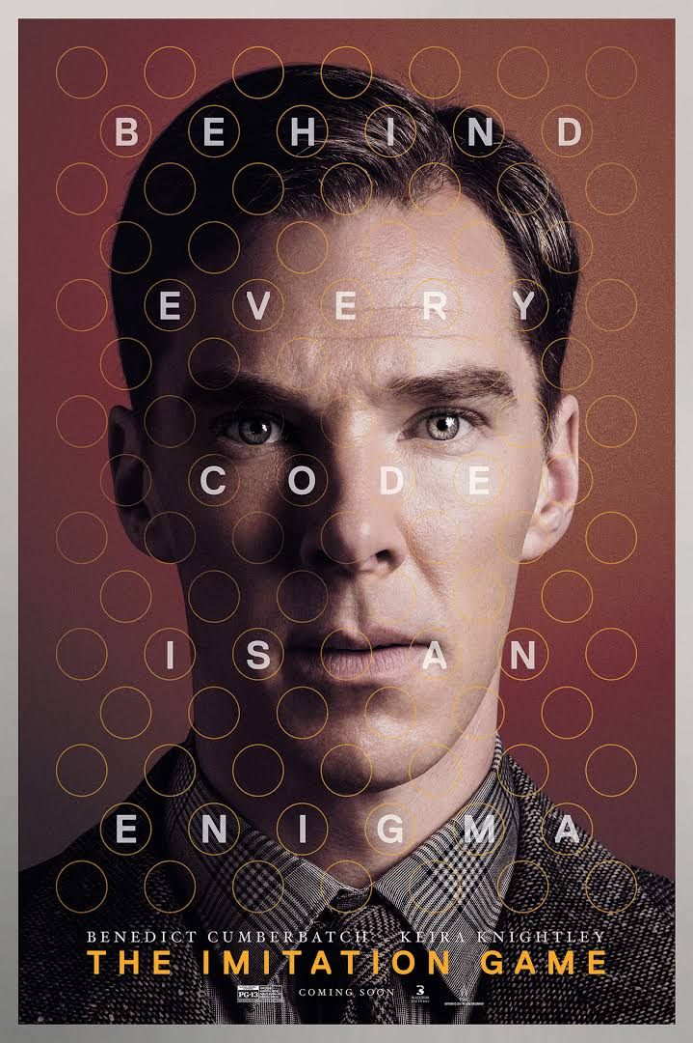
The imitation game

Slide 17
The turing machine
First proposed by Alan Turing in 1936 (when he was 24).
One way to think of a Turing machine is as a very simplistic programming language.
Similar to a finite automaton but with an unlimited and unrestricted memory.
A Turing machine (TM) can do everything a real computer can do.
Some problems lie beyond the capability of a Turing machine (TM). These problems are beyond the theoretical limits of computation.

Slide 18
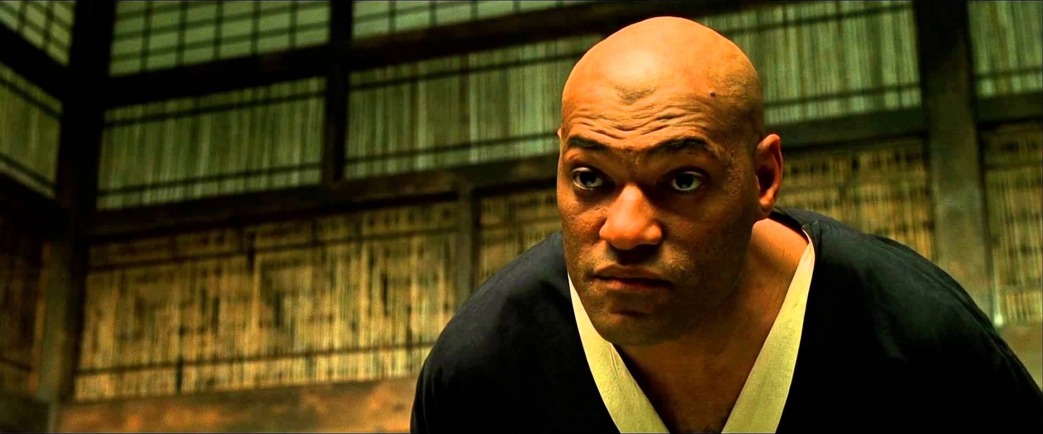
PC vs TM and The Sapir-Whorf Hypothesis
A PC has finite memory!
Do you think that’s a universal model of computation
you are computing with right now?

Slide 19
In a TM, an infinite tape is used to model unlimited memory.
A finite string is initially placed on the tape and denotes the input to the TM.
A TM can read and write from its tape via a read-write head.
The read-write head can move both to the left and right on the tape.
Rejecting and accepting states take effect immediately (the computation halts when such a state is reached).
Computation continues until an accepting or rejecting state is reached.

Slide 20
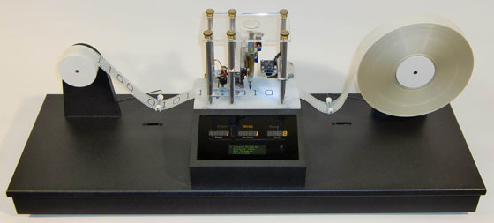

Slide 21
A Turing machine is a 7-tuple (Q,Σ,Γ,q₀,q_{accept},q_{reject}) where Q, Σ, and Γ are all finite sets and
Q is the set of states,
Σ is the input alphabet where the blank symbol b ∉ Σ
Γ is the tape alphabet, where b ∈ Γ ∧ Σ ⊆ Γ,
δ : Q x Γ → Q x Γ x {L,R} is the transition function,
q₀ ∈ Q is the start state,
q_{accept} ∈ Q is the accept state, and
q_{reject} ∈ Q is the reject state, where q_{reject} ≠ q_{accept}

Slide 22
A variation of the tm
The variation of a TM that we will consider needs no accept/reject states. Our machine halts when no more transitions can be made.
Our TM will run as long as (well-formed) transitions are possible (e.g., it is possible for a TM to run indefinitely).
After our TM has halted, there are two ways it can communicate the results of its computation.
The final internal state.
The contents of the tape.

Slide 23
Example: An Even-odd recognizer
1→R
even
even
even
even
odd
odd
odd
odd
1→R
1
1
1
b

Slide 24
Example: Counting 1’s
0→R
1→R
even
even
even
odd
odd
odd
1→R
0→R
0
1
0
1
b

Slide 25
Example: Counting and Replacing 1’s
1→x,R
even
even
even
even
odd
odd
odd
odd
1→y,R
x
1
y
1
1
x
b

Slide 26
Example: L = { 0^{n}1^{n} | n ≥ 0}
L = { ε, 01, 0011, 000111, … }
We assume input will be of the form 0^{n}1^{m}
Note that L ⊆ 0^{n}1^{m}
Can your algorithm handle large n and m?

Slide 27
An algorithm
[0]00…00111…11b
Let us assume we are only analyzing strings of the form 0^{n}1^{m}
x00…00[1]11…11b
x[0]0…00y11…11b
xx0…00y[1]1…11b
xx[0]…00yy1…11b
x x x … x x y y y … y y[b]
xxx…00 yy[1]…11b
x x x … x[0]y y y … y 1 b
x x x … x x y y y … y[1]b
x x x … 0 0 y y[1]… 1 1 b
x x 0 … 0 0 y[1]1 … 1 1 b
x x[0]… 0 0 y y 1 … 1 1 b
x 0 0 … 0 0[1]1 1 … 1 1 b
x[0]0 … 0 0 y 1 1 … 1 1 b
[0]0 0 … 0 0 1 1 1 … 1 1 b
…
xxx…x[0]yyy…y1b
xxx…xxyyy…y[1]b
…
xxx..xxyyy…yy[b]

Slide 28
0→L
y→L
advance to zero
x→x,R
1→y,L
replace
zero
replace
one
advance to one
0→x,R
1→1,R
0→R

Slide 29
0→L
y→L
advance to zero
x→x,R
1→y,L
replace
zero
replace
one
advance to one
0→x,R
1→1,stay
0→R
y→R

Slide 30
questions
What state does the machine end up in if there are more 0's than 1's?
What state does the machine end up in if the number of 0's is equal to the number of 1's?
What state does the machine end up in if there are more 1's than 0's?

Slide 31
0→L
y→L
advance to zero
y→y,R
x→x,R
1→y,L
replace
zero
replace
one
advance to one
0→x,R
1→1,stay
1→1,R
reject
0→R
y→R

Slide 32
0→L
y→L
advance to zero
y→y,R
x→x,R
replace
zero
1→y,L
advance to one
0→x,R
1→1,R
reject
0→R
y→R

Slide 33
Computational equivalence
Three equivalent languages

Slide 34
Language 1
Turing Machine (variation)
States
Read/Write Head
Symbols
Transitions

Slide 35
Language 2
integer variables that may contain values of arbitrary magnitude
arithmetic operations
assignment statements
conditional statements
sequential execution of statements
indefinite iteration (e.g., while-loops)

Slide 36
Language 3
integer values of arbitrary magnitude
arithmetic functions (i.e., operations)
conditional expressions
recursive parameterized function definitions

Slide 37
The Importance of the tm
A Turing machine is a very simple model of computation.
A Turing machine is a universal model of computation. What this means is that any computation that can be expressed in any programming language can also be expressed in a Turing machine. What does this mean? After all, the computational steps will certainly not be identical.
It is relatively easy to show that a sufficiently rich language is Turing complete (i.e., equivalent in computing power to a Turing machine).
The notion that a sophisticated language (e.g., Java) is equivalent to a simple language (e.g., Java bytecodes) is a key enabler of computer technology - It allows translations between complex and simple languages!

Slide 38
The End

